Slide 1
Cellular image

Slide 2
Aim:
提供不同白平衡之細胞影像以供分析

Slide 3
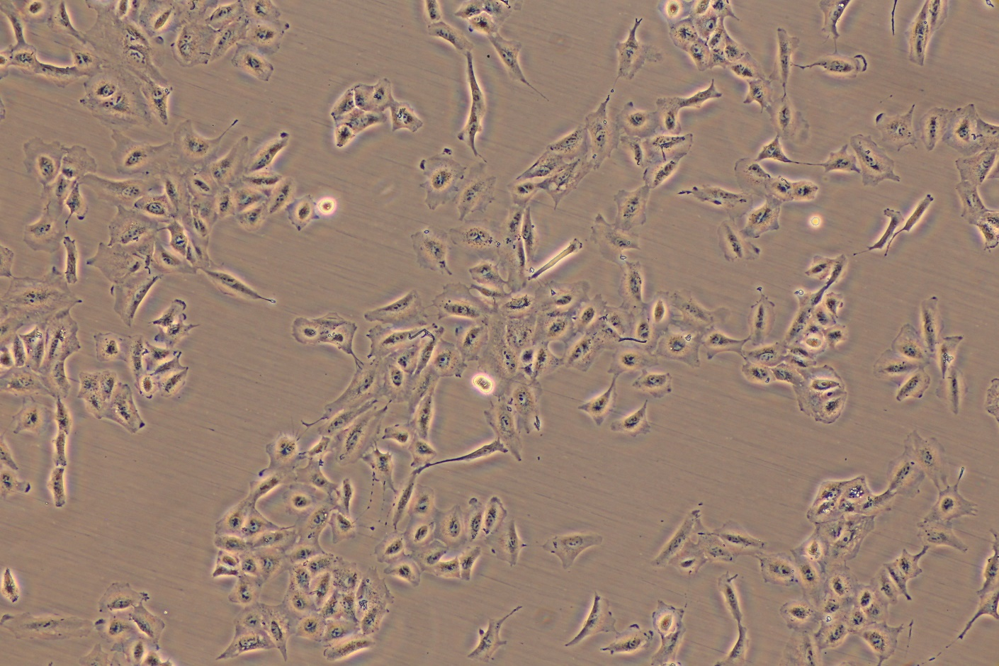
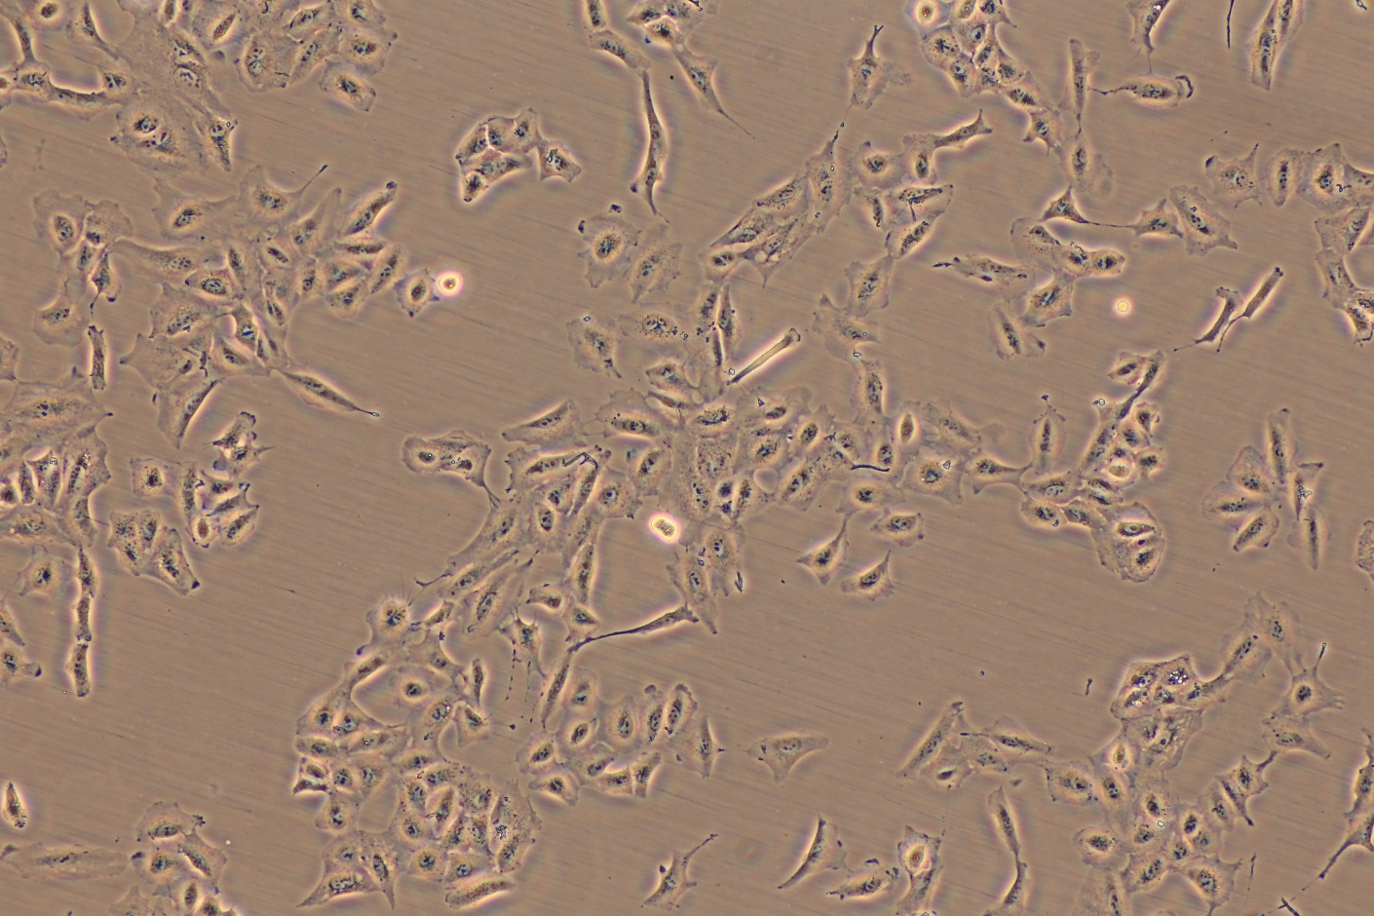
Magnification: 100X
Filter: pH1
Shutter : 1/6 s
ISO: 1600
White balance: Auto
Magnification: 100X
Filter: pH1
Shutter : 1/6 s
ISO: 1600
White balance: Sunny
Cell line: A549
Camera: CANON EOS 6D
Date: 2015 Nov. 4

Slide 4
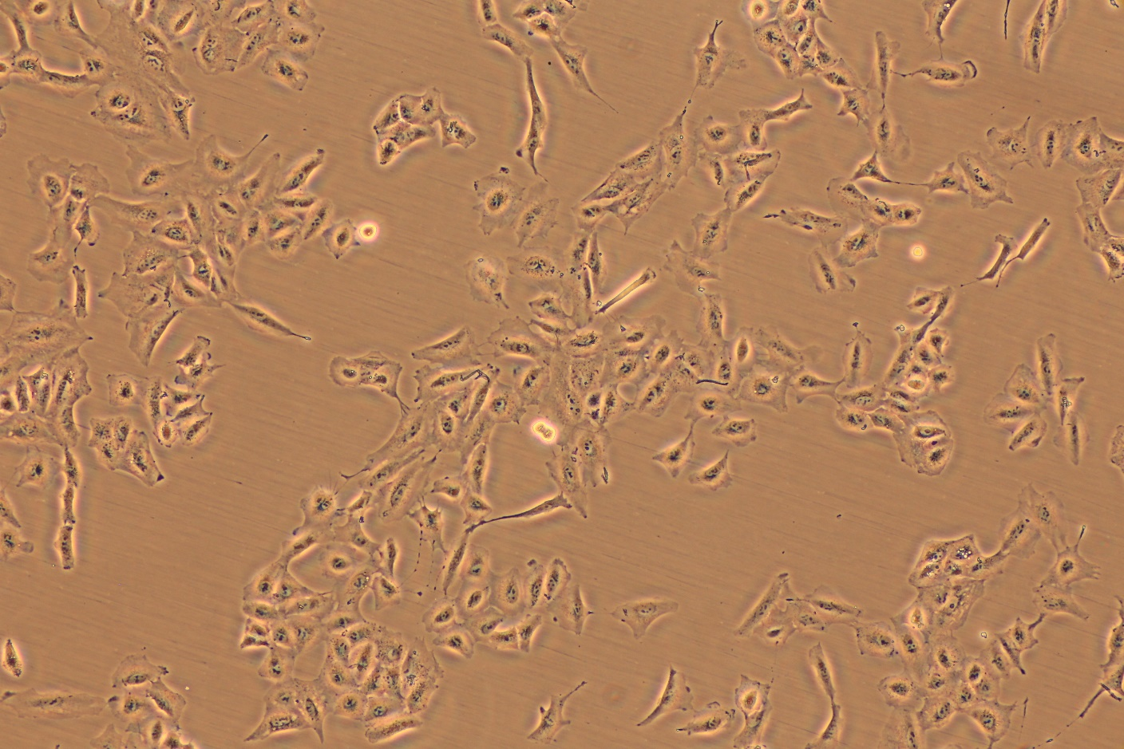
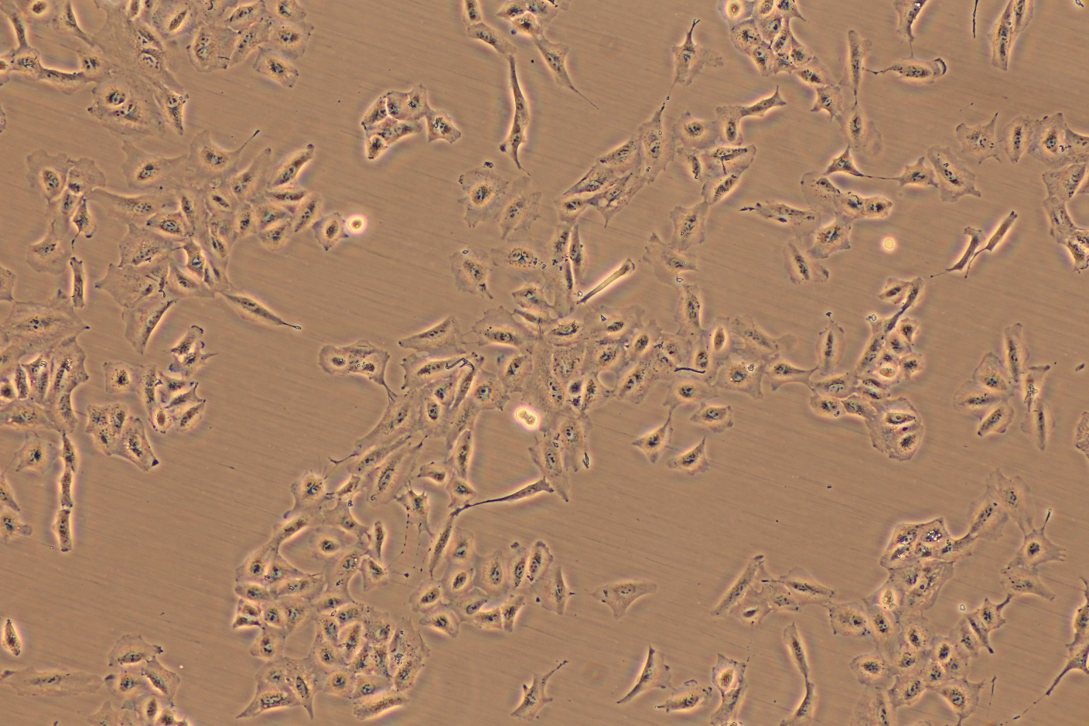
Magnification: 100X
Filter: pH1
Shutter : 1/6 s
ISO: 1600
White balance: Shadow
Magnification: 100X
Filter: pH1
Shutter : 1/6 s
ISO: 1600
White balance: Cloudy
Cell line: A549
Camera: CANON EOS 6D
Date: 2015 Oct.28

Slide 5
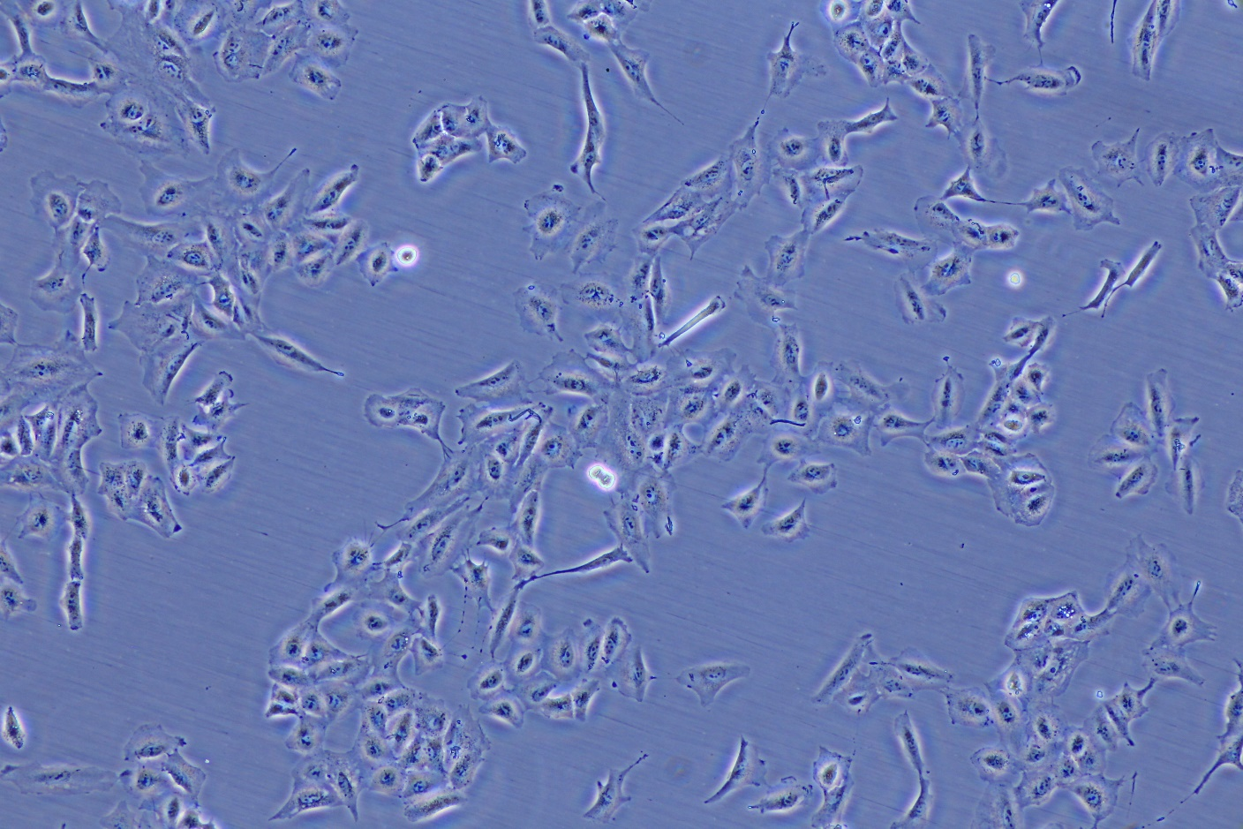
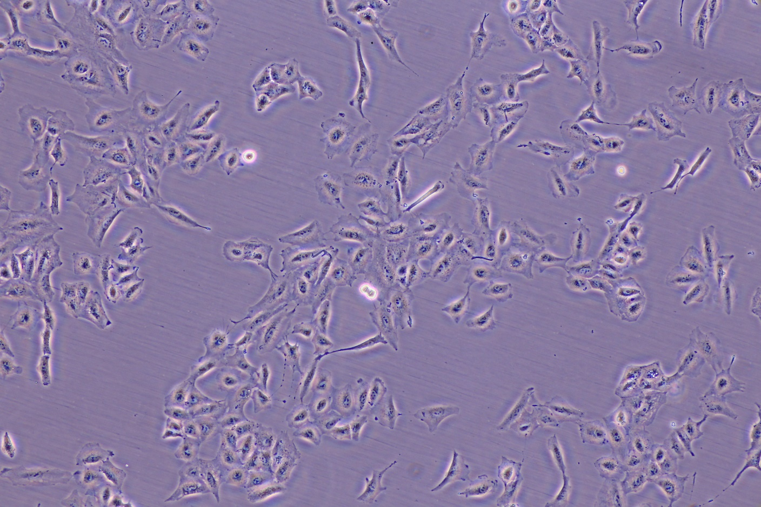
Magnification: 100X
Filter: pH1
Shutter : 1/6 s
ISO: 1600
White balance: Tungsten
Magnification: 100X
Filter: pH1
Shutter : 1/6 s
ISO: 1600
White balance: Fluorescent
Cell line: A549
Camera: CANON EOS 6D
Date: 2015 Nov. 4

Slide 6
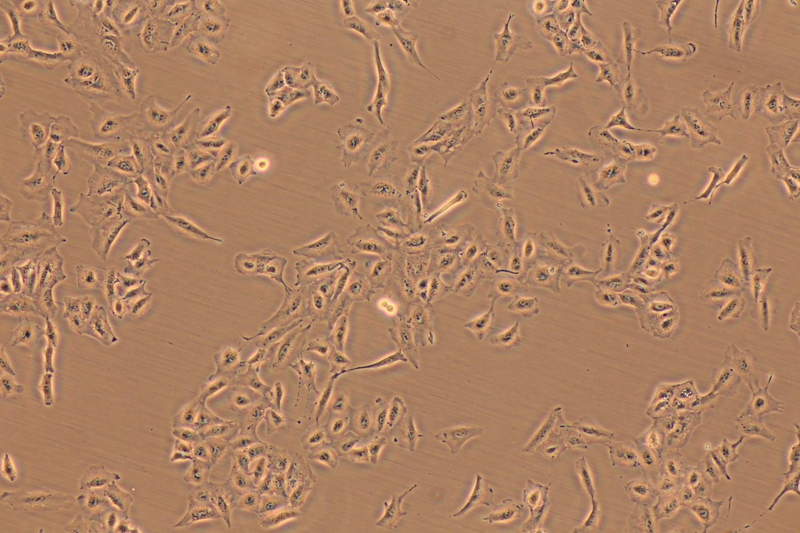
Magnification: 100X
Filter: pH1
Shutter : 1/6 s
ISO: 1600
White balance: Flash
Cell line: A549
Camera: CANON EOS 6D
Date: 2015 Nov. 4

Slide 7
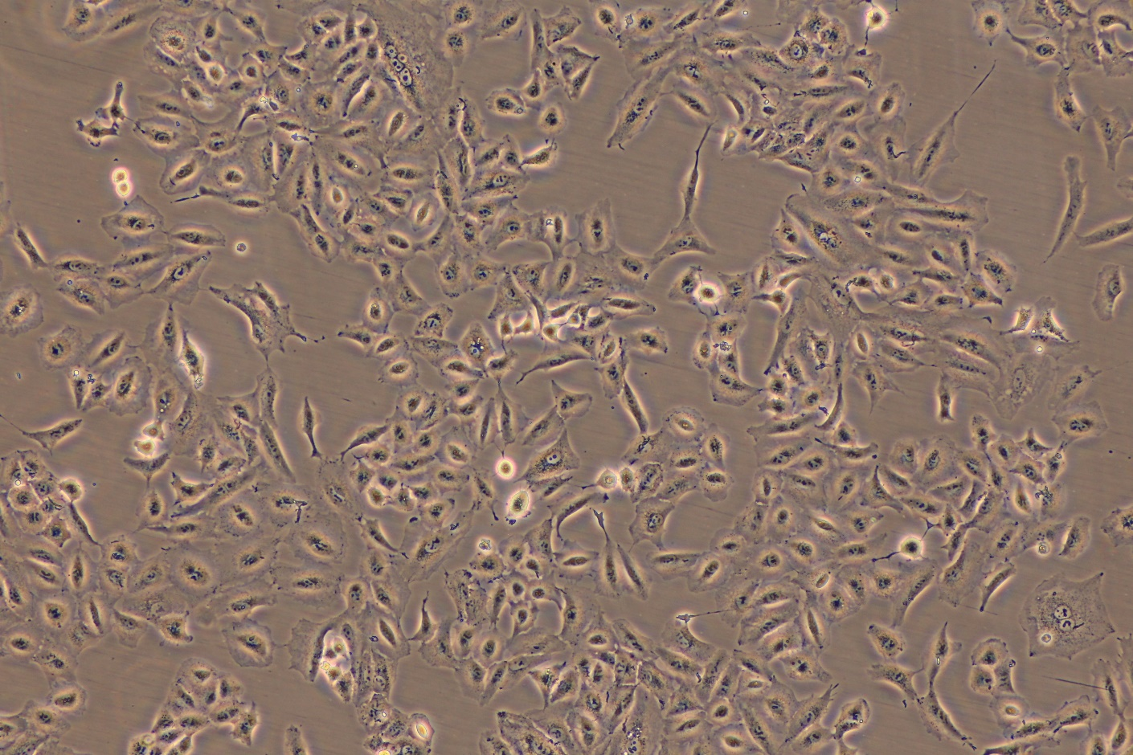
Magnification: 100X
Filter: pH1
Shutter : 1/6 s
ISO: 1600
White balance: Auto
Magnification: 100X
Filter: pH1
Shutter : 1/6 s
ISO: 1600
White balance: Auto
Cell line: A549
Camera: CANON EOS 6D
Date: 2015 Nov. 4

Slide 8
Conclusion:
此次A549貼附生長時間約為48小時。
曝光時間、光圈、外部光源等等全部固定不變。

